Slide 1
COPADS
#1 - Introduction
IFEOLUWATAYO IGE

Slide 2

Introductions
Welcome to COPADS!
I’ll go first:
My Name: IfeoluwaTAYO Ige
Ph.D.(Computer Science)
Hobbies: Playing the Violin, Singing, Watching Basketball.
2 daughters: Victoria and Gloria
You go next..,

Slide 3

You and I are partners in COPADS.
We will be working and learning together this semester.
Please feel free to reach out to me via:
Email (send it anytime, I promise to respond as soon as I can)
Office hours @3557: Mondays and Wednesdays: 11.00 am -12.00 pm

Slide 4

Course Expectations
COPADS is an exciting course. There will be:
Lectures to listen to and a few videos related to the topic
Problem-solving sessions which will be fun.
There will be 3 exciting projects.
COPADS is a SECOND YEAR COURSE.
This is an introductory course. Concepts and techniques will be discussed MODERATELY.
Do not feel you are not gaining anything (especially if you are in your Third-Fifth Year) as we will likely discuss stuff you already know.
COPADS is text-bulky…,

Slide 5
Let’s see the following on MyCourses:
The Syllabus
The Course schedule

Slide 6
Course Schedule
The course is divided into Modules
Modules may take varying amounts of time
MAY not correspond to the weekly directory
Topic based

Slide 7
Grader
Brandon Kirincich (bjk3435@rit.edu)

Slide 8
Ok, so what tools are we using this semester?
Programming language: C#
Cross-platform Application Network: .NET Framework
The .NET framework consists of the Common Language Runtime and the .NET Framework Class Library
The runtime provides services like thread management, garbage collection, type safety, and exception handling.
The Class Library includes APIs for reading and writing files; provides types for strings, dates, numbers, etc.
Available from https://dotnet.microsoft.com/download/dotnet
Install version 7.

Slide 9
A Note on Installation
Window Users: Install Visual Studio. It includes .NET 7
For MacOS,
https://devblogs.microsoft.com/visualstudio/visual-studio-for-mac-retirement-announcement/#:~:text=While%20not%20officially%20supported%2C%20we,for%20building%20and%20debugging%20applications.
Visual Studio IDE running on Windows (VM on Mac)
Visual Studio Code with C# Dev Kit and related extensions
https://learn.microsoft.com/en-us/dotnet/core/install/macos
Jetbrains makes Rider (cross platform IDE), which is very compatible.
For Unix systems, https://learn.microsoft.com/en-us/dotnet/core/install/linux-ubuntu
Any editor will work if you run the tools manually (installing .NET stuff)
Vim
Visual Studio Code
Sublime

Slide 10
Basic process
Open a command prompt
Run ‘dotnet new console’
This will create a program.cs file and a csproj file in the current directory
.cs file – your code
Csproj file- consist of all information required for building your code. Such as assemblies, included packages, version of the framework used when the code was written, etc.
You can create other types of projects by specifying things other than the console when you create the project
https://learn.microsoft.com/en-us/dotnet/core/tools/dotnet-new
Can also be done in Rider/Visual Studio through New Project menu

Slide 11
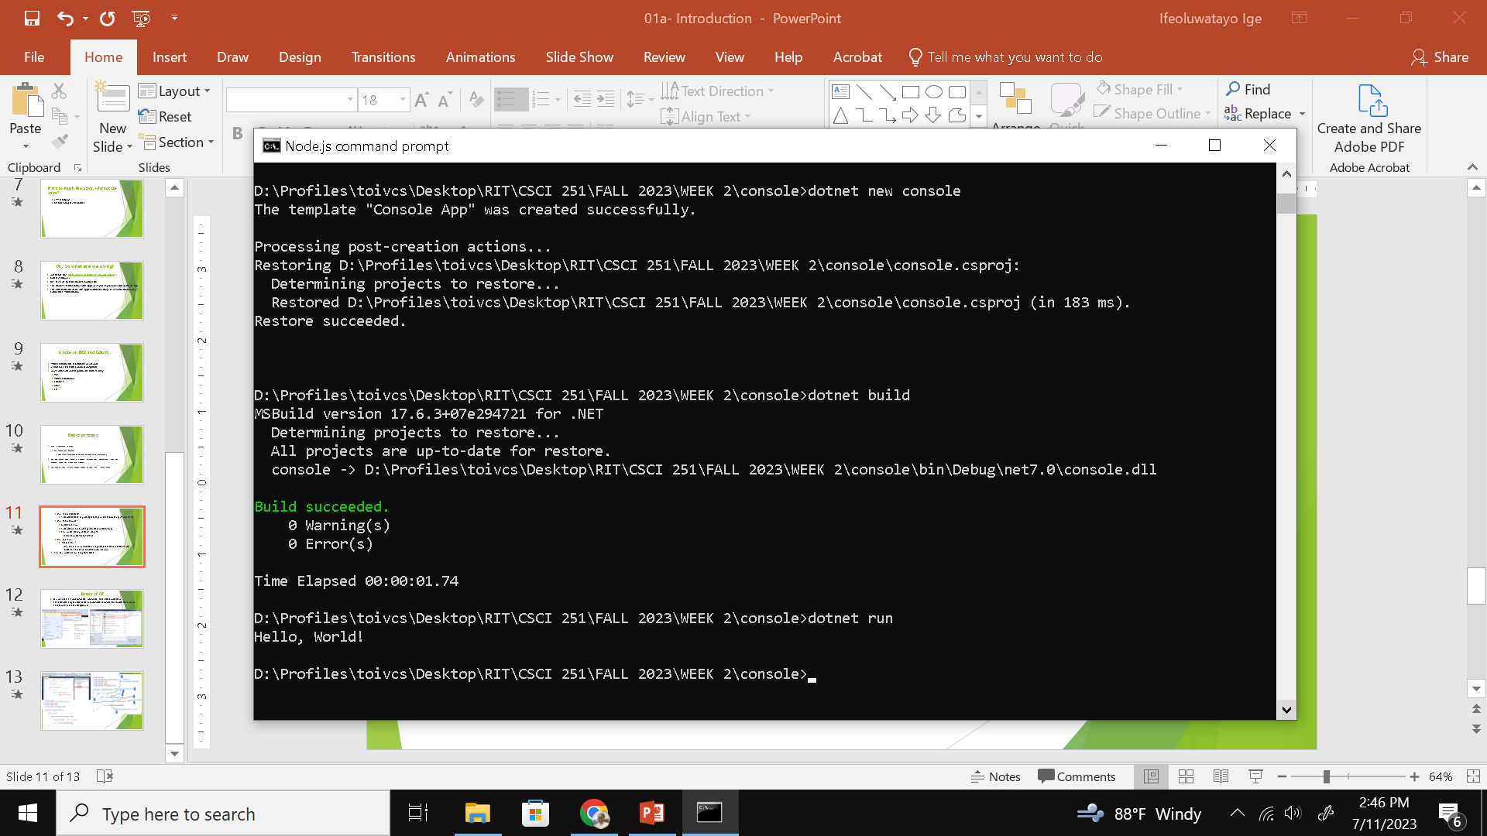
Run ‘dotnet restore’
This will restore any packages that you need (dependency management)
Run ‘dotnet build’
Builds the app
This will be the app for your current platform only
Can build for any platform, using -r
dotnet build -r osx.10.10-x64
Run the app
‘dotnet run’
Runs the app, but this is running with the current .net framework, instead of the one embedded with the app (Visual studio)

